Slide 1

Cooperative Conservation and Management of the Marine Environment and Resources in China Seas
WANG Hanling
Center for Ocean Affairs & the Law of the Sea
Chinese Academy of Social Sciences
Email: cass_wang@126.com
Workshop on Beyond Sovereignty: Issues For Cooperation In China Seas
Macerata University, Italy, 14 April 2015

Slide 2
“Semi-enclosed sea” in UNCLOS
Article122 Definition
"enclosed or semi-enclosed sea" means a gulf, basin or sea surrounded by two or more States and connected to another sea or the ocean by a narrow outlet or consisting entirely or primarily of the territorial seas and exclusive economic zones of two or more coastal States.
Article123 Cooperation of States bordering enclosed or semi-enclosed seas
Littoral states should cooperate in the exercise of their rights and duties ,… shall endeavour, directly or through an appropriate regional organization:
(a) to coordinate the management, conservation, exploration and exploitation of the living resources of the sea;
(b) to coordinate the implementation of their rights and duties with respect to the protection and preservation of the marine environment;
(c) to coordinate their scientific research policies and undertake where appropriate joint programmes of scientific research in the area;
(d) to invite, as appropriate, other interested States or international organizations to cooperate with them in furtherance of the provisions of this article.

Slide 3
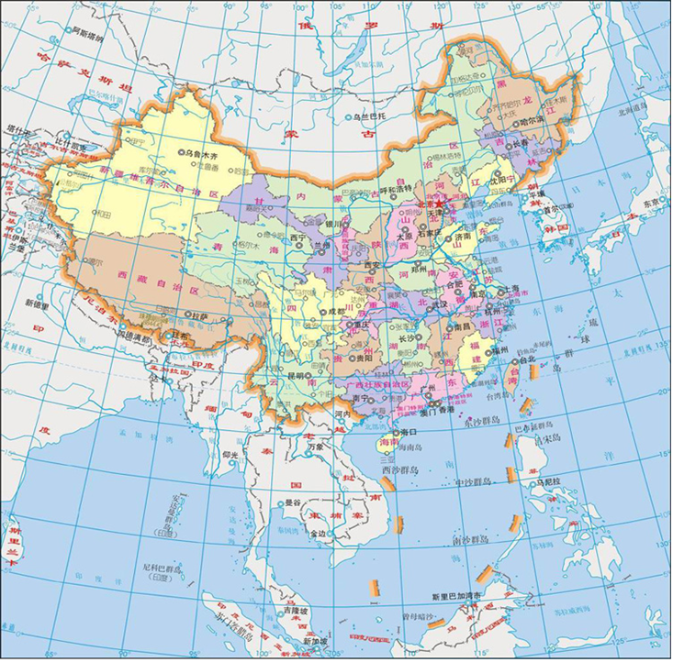
Semi-enclosed seas in East Asia: the Yellow Sea, the East China Sea and the South China Sea

Slide 4
Semi-enclosed seas in East Asia: Characteristics
Disputed seas without maritime delimitation (except the Gulf of Beibu / Tokin );
2. No regional marine management organization;
3. Unitary marine ecosystems facing serious deterioration of the marine environment / resources.

Slide 5
The Yellow Sea
The Yellow Sea Large Marine Ecosystem Project (UNDP / GEF)
Participating countries: China and Republic of Korea
(North Korea has not participated)
Major Outputs:
1. Transboundary Diagnostic Analysis (TDA)
2. Strategic Action Plan (SAP)
3. National Yellow Sea Action Plans (NYSAPs)

Slide 6
Transboundary Diagnostic Analysis (TDA)
The status of the marine ecosystem is assessed by the 5-module-approach (1) productivity, (2) fish and fisheries, (3) pollution and ecosystem health, (4) socioeconomics; (5) governance.

Slide 7
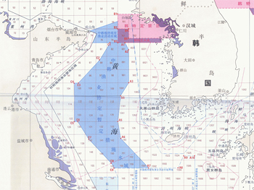
The Sino-South Korea Fisheries Agreement (2000)
(China – ROK Provisional Fisheries Management Zone
Sino-ROK Fisheries Joint Patrol)

Slide 8
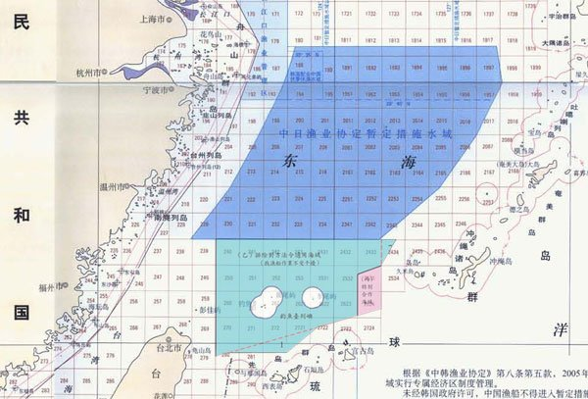
The Sino-Japanese Fisheries Agreement (1997)
+ Taiwan-Japan Fisheries Agreement (2013)

Slide 9
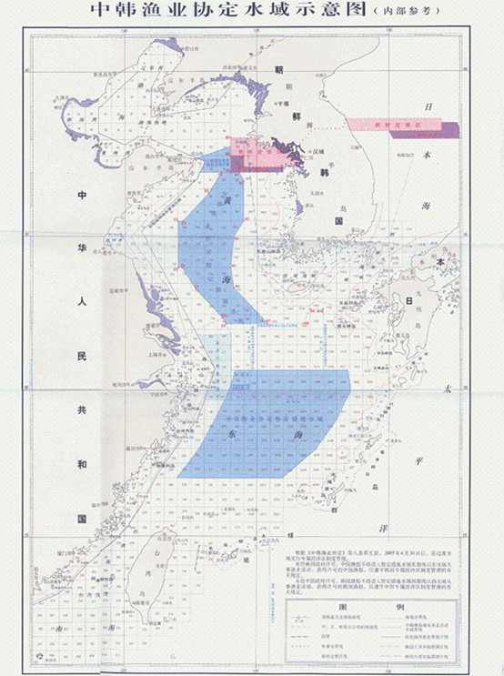

Slide 10
The South China Sea
No regional organization for the marine environment / resources including fisheries;
DOC (the Declaration on the Conduct of Parties in the South China Sea, signed by China and ASEAN countries in 2002)
Art. 1: The Parties reaffirm their commitment to the purposes and principles of the Charter of the United Nations, the 1982 UN Convention on the Law of the Sea…
Art. 6: Pending a comprehensive and durable settlement of the disputes, the Parties concerned may explore or undertake cooperative activities. These may include the following:
1) marine environmental protection;
2) marine scientific research; …
China unilaterally established the SCS cooperation fund of 3 billion RMB.

Slide 11
In 2011, China set up the China-ASEAN Maritime Cooperation Fund of 3 billion RMB to promote marine environmental protection, maritime science and technology, maritime connectivity, safety of navigation and rescue, as well as combating transnational crimes.

Slide 12
Sino-Vietnamese agreements on the Gulf of Beibu / Tonkin (Dec. 2000)
1) maritime boundary in the Gulf of Beibu (Tonkin);
2) fisheries arrangements in designated water areas.
(The Supplimentary Protocol to the Fisheries Agreement; the Regulations on Conservation and Management of the Fishery Resources in CFZ, 2004)

Slide 13
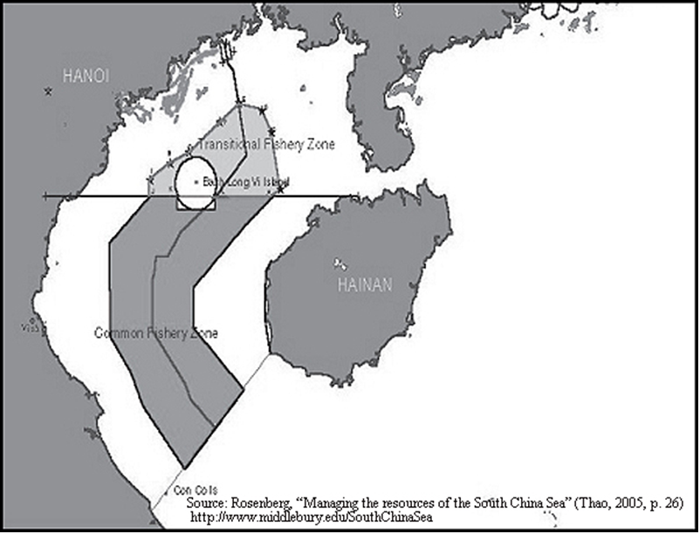

Slide 14
Sino-Vietnamese Fisheries Joint Patrol
Mechanisms for implementing the Fishery Agreement & Regulations:
1)The Joint Fishery Committee consisting of representatives from the departments of Fishery Administration, Foreign Affairs, Public Security and Border Protection as well as navies of both countries;
2) the joint Experts Group on fisheries resources (joint research on fishery resources) in CFZ;
3) Law Enforcement (joint patrol).

Slide 15
Joint patrol / bilateral fishery law enforcement cooperation in the Common Fishing Zone (CFZ).
Purposes: 1) coordination in implementing agreed regulations on marine resources; 2) Preserving and promoting bilateral relations.
Who, What & How: Law enforcement officials from both sides exchange experience in monitoring and (jointly) inspecting fishing activities, informing each other of their enforcement activities, ensuring maritime safety (S&R), security and good order of fishing activities.

Slide 16
Partnerships in Environmental Management for the Seas of East Asia (PEMSEA)
Known as “Prevention and Management of Marine Pollution in the East Asian Seas” (SDS-SEA), is a regional partnership program implemented by UNDP, started in 1994.
Country Partners: Cambodia, China, Indonesia, Japan, Laos, North Korea, Philippines, South Korea, Singapore, Thailand, Timor-Leste, Vietnam
PEMSEA's areas of work: coastal and ocean governance, hazard prevention and management, habitat protection, restoration and management, water use and supply management, pollution and waste reduction management, food security and livelihood management.
Goal: to promote sustainable development in the region.

Slide 17
Major Issues / Problems
1. Lack of regional marine management organizations and mechanisms (regionalization) although most littoral states are parties to international conventions related to conservation and management of the marine environment and living resources;
2. Ineffective bilateral mechanisms / implementation;
3. Ecosystem approaches to ocean management in China seas?

Slide 18
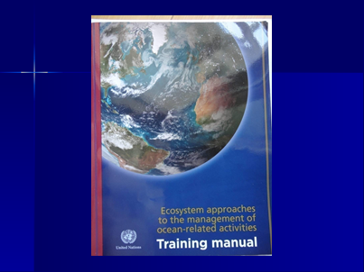

Slide 19
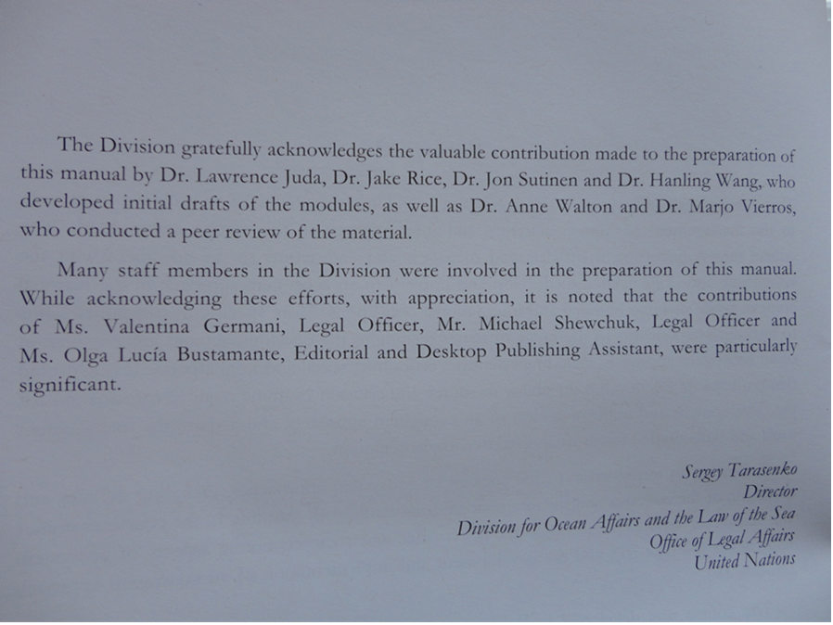

Slide 20
Conclusions / recommandations
1. Semi-enclosed seas in East Asia should be coorperatively managed in accordance with UNCLOS and other international agreements;
2. Measures / mechanisms in the Gulf of Beibu / Tokin can be improved and used in other sea areas;
3. Appropriate conservation / management mechanisms and measures (including joint management / development) should be adopted in undelimitated / disputed sea areas;
4. Scientific and innovative approaches such as ecosystem approaches should be adopted;
5. International organizations such as UN (including UNEP, UNDP, IMO, FAO...) should play more important roles (especially in disputed sea ereas);
6. Experiences and lessons learned in other sea areas in the world can be borrowed.

Slide 21


